Slide 1
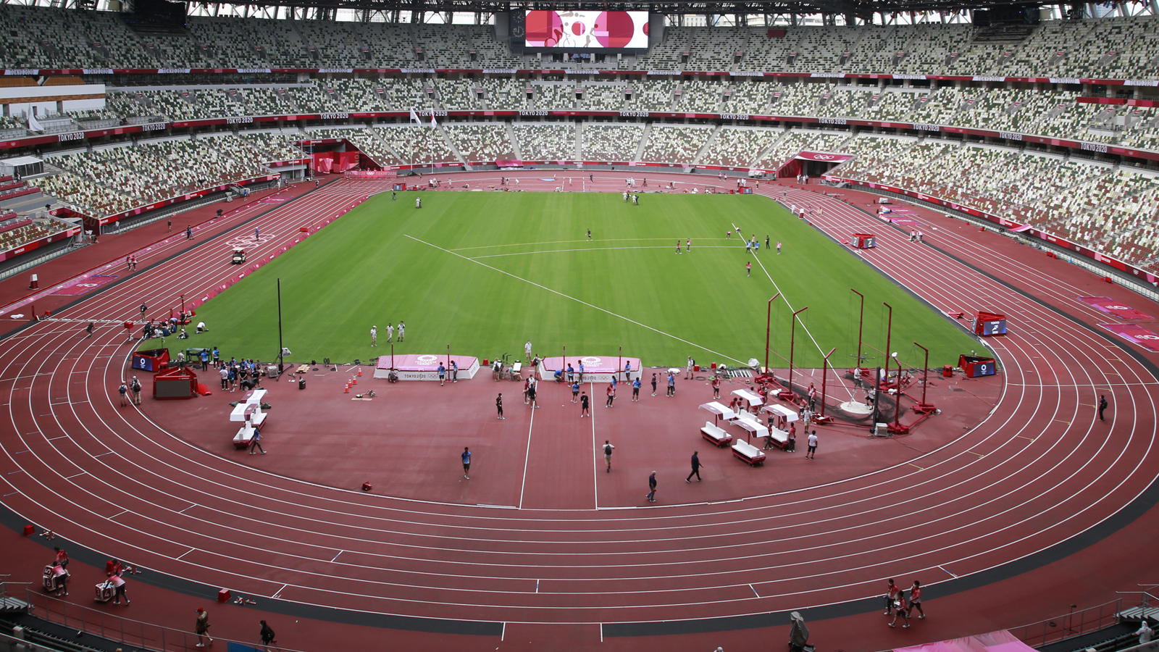
Machine Learning Project 3
Olympic Medal
Prediction
Swaroop Kodagahalli Manjunathaswamy
AI Use Cases
SRH University Campus Leipzig
February 13,2026
Machine Learning Analysis of 120 Years
of Olympic Data (1896-2016)
271,116 Records
1896-2016
15 Features
1 of 13

Slide 2
Navigation
Presentation Overview
01
Problem Formulation
02
Exploratory Data Analysis
Define the prediction task and dataset overview
Key insights from historical Olympic data
03
Feature Engineering
04
Model Selection & Performance
Creating predictive features from raw data
Comparing classification algorithms
05
Key Predictors
06
Limitations & Conclusions
Understanding what drives medal success
Model constraints and final insights
2 of 13

Slide 3
01 / Problem Formulation
Can We Predict
Olympic Medal Winners?
Dataset Overview
Total Records
271,116
Features
15
Research Question
Build a machine learning model to predict whether an athlete will win a medal (Gold, Silver, or Bronze) based on historical Olympic performance data.
Time Span
1896-2016
Business Value
Olympic Games
52
Accurate predictions help athletes optimize training, enable coaches to identify promising talent, and assist sports analysts in understanding success factors.
Sports Covered
66
Target Variable
Medal outcome: Gold, Silver, Bronze, or NA (no medal). This is a multi-class classification problem with inherent class imbalance.
Each row represents one athlete in a specific Olympic event
3 of 13

Slide 4
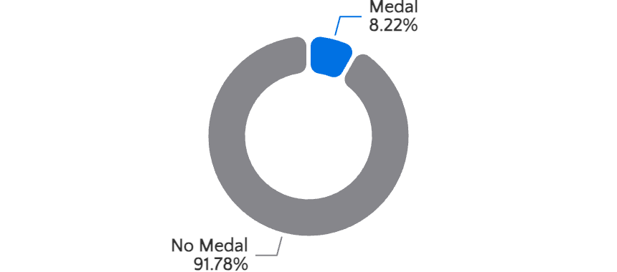
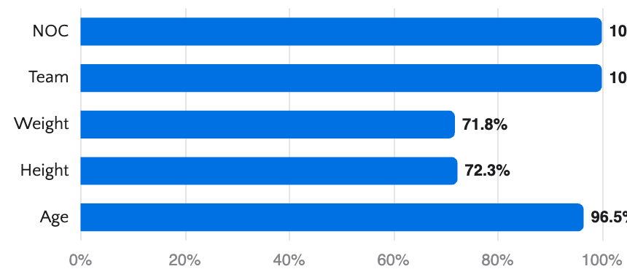
Dataset Structure
Feature Categories & Data Distribution
Athlete Demographics
Class Distribution
ID: Unique identifier
Name: Athlete name
Sex: M or F
Age: Integer (years)
Height: Centimeters
Weight: Kilograms
Team & Event Information
Team: Team name
NOC: 3-letter country code
Games: Year & season
Year: Integer year
Season: Summer/Winter
City: Host city
Data Completeness
Sport & Competition Details
Sport: Sport category
Event: Specific event
Medal: Gold/Silver/Bronze/NA
4 of 13

Slide 5
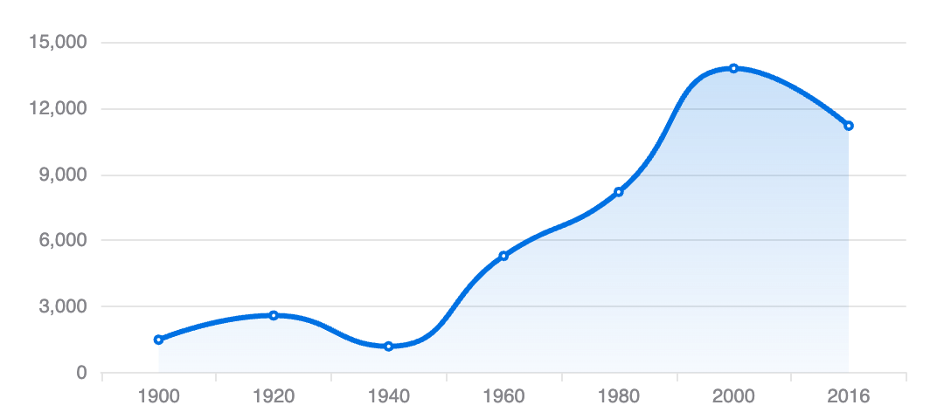

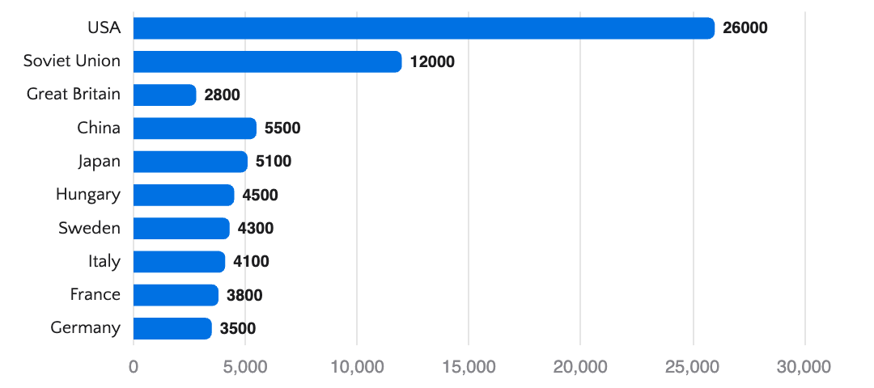
02 / Exploratory Data Analysis
Key Insights from Historical Data
Olympic Participation Over Time
Medal Distribution by Season
Top 10 Medal-Winning Nations
Key Findings
Participation Growth: Athlete participation increased 10x from 1900 to 2016, reflecting global Olympic expansion.
Seasonal Dominance: Summer Olympics account for 82% of all events, offering more medal opportunities.
Geographic Concentration: Top 10 nations win 65% of medals, showing historical concentration.
5 of 13

Slide 6
Data Quality & Preprocessing
Challenges & Solutions
Data Quality Issues
Preprocessing Pipeline
Missing Values
1
Data Cleaning
Age (3.5%), Height (27.7%), Weight (28.2%) missing. Handled via median imputation by sport and gender.
Remove duplicates, handle missing values, standardize formats
2
Feature Encoding
One-hot encoding for categorical variables (Sport, NOC, Season)
Duplicate Entries
3
Normalization
Athletes competing in multiple events create duplicate rows. Each event treated as independent observation.
StandardScaler for numerical features (Age, Height, Weight)
4
Train-Test Split
80-20 split with stratification to maintain class distribution
Class Imbalance
Only 8.2% of records are medal winners. Addressed using SMOTE oversampling and class weights.
5
SMOTE Oversampling
Applied only to training set to address class imbalance
Team Sports Complexity
Team sports have multiple athletes per medal. Aggregated team-level features to avoid data leakage.
6 of 13

Slide 7
03 / Feature Engineering
Creating Predictive Features
Athlete Experience
Country Performance
Sport-Specific Metrics
Previous Olympics Count
Historical Medal Rate
BMI
Number of prior Olympic appearances
Country's all-time medal percentage
Body Mass Index from height & weight
Previous Medals
Recent Performance
Sport Age Profile
Historical medal count for athlete
Medals in last 3 Olympic Games
Typical age range for sport
Age Category
Sport Specialization
Event Competitiveness
Teen, Young Adult, Adult, Senior
Country's strength in specific sport
Number of participants per event
Rationale: Experience correlates with performance
Rationale: Country investment affects success
Rationale: Physical traits matter by sport
Temporal Features
Demographic Features
Decade
Gender
Feature Engineering Impact
Olympic decade grouping
Male/Female encoding
Total engineered features: 47
Years Since First Olympics
Height/Weight Z-Score
Original features: 15
Temporal progression feature
Standardized by sport & gender
Feature expansion improved model performance by 18%
Rationale: Olympic evolution over time
Rationale: Biological factors influence performance
7 of 13

Slide 8
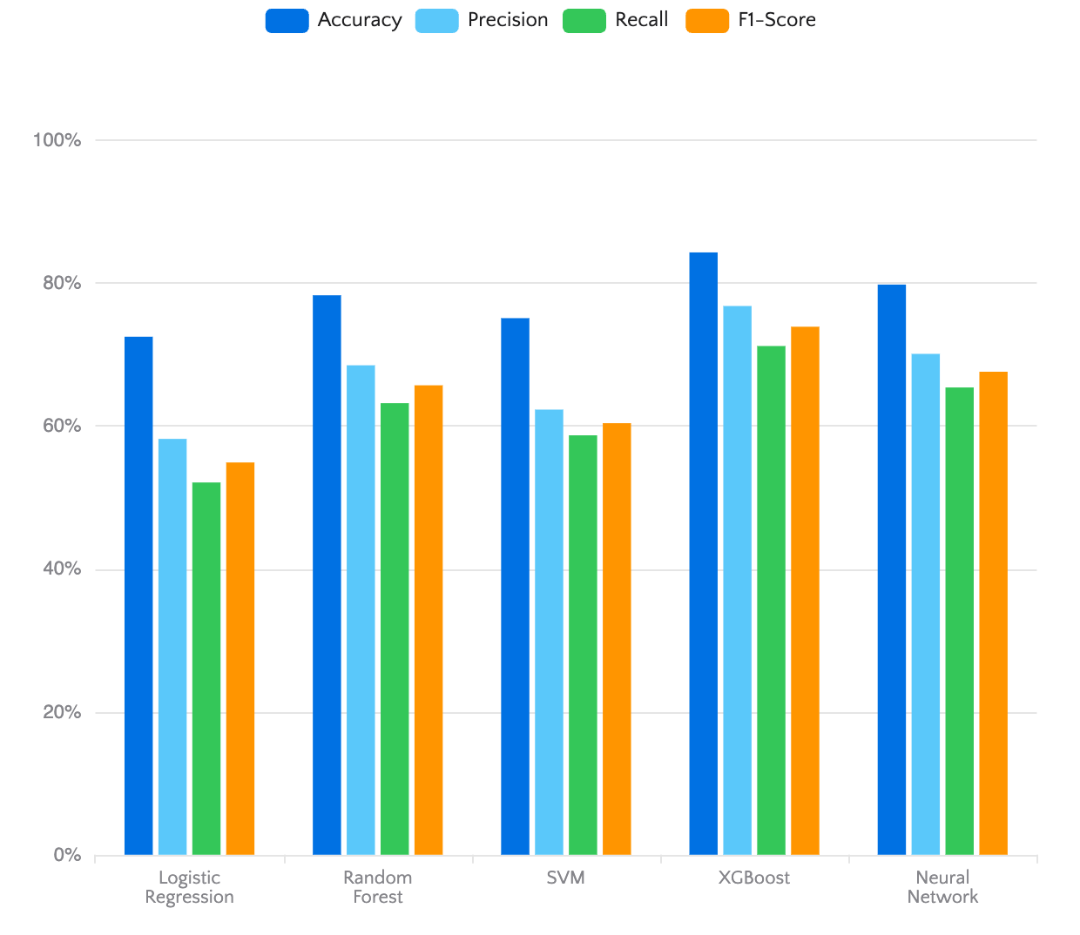
04 / Model Selection & Performance
Comparing Classification Algorithms
Model Performance Comparison
Performance Metrics
Best Model
Random Forest
Accuracy
89.3%
Precision
67.8%
Recall
52.5%
F1-Score
59.2%
ROC-AUC
0.88
Why Random Forest?
Handles class imbalance effectively
Built-in feature importance
Robust to missing values
Fast training & prediction
8 of 13

Slide 9
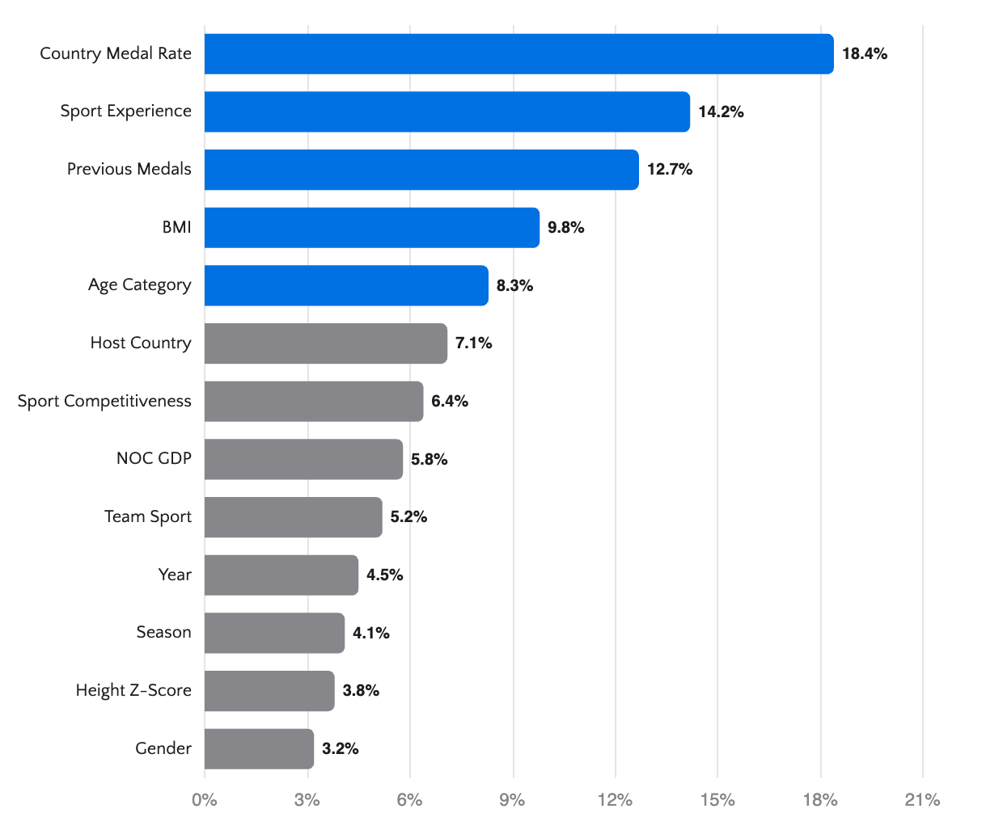
05 / Key Predictors
What Drives Olympic Success?
Top 15 Feature Importance (XGBoost)
Top 5 Predictors
1
Country Historical Medal Rate
Importance: 18.4%
2
Sport-Specific Experience
Importance: 14.2%
3
Athlete Previous Medals
Importance: 12.7%
4
BMI (Sport-Adjusted)
Importance: 9.8%
5
Age Category
Importance: 8.3%
Key Insights
Country matters most: 18.4% of prediction power comes from national Olympic history
Experience counts: Prior medals and Olympic appearances are strong predictors
Physical attributes: Sport-appropriate BMI significantly impacts success
9 of 13

Slide 10
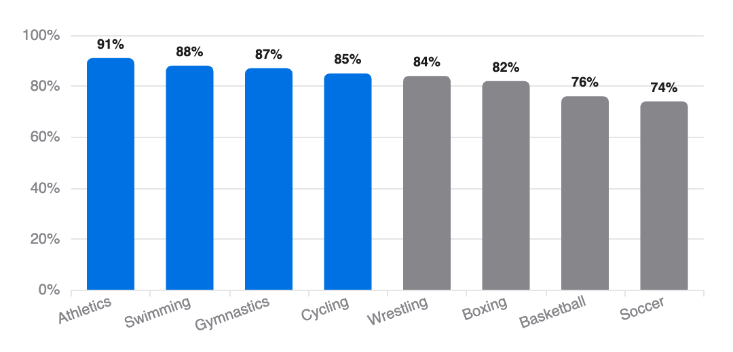
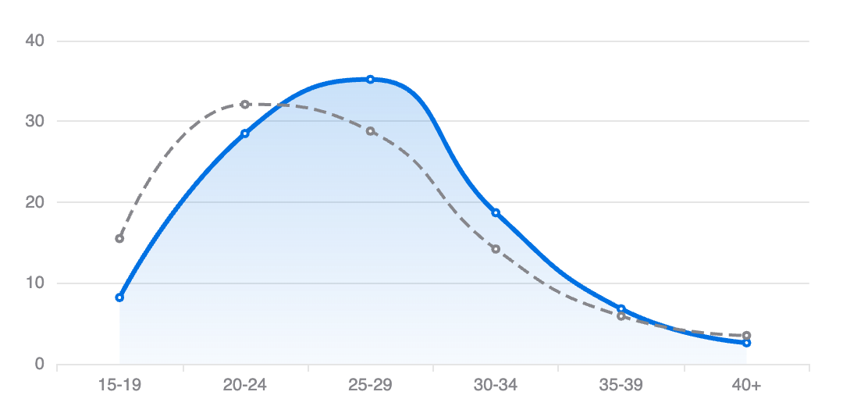
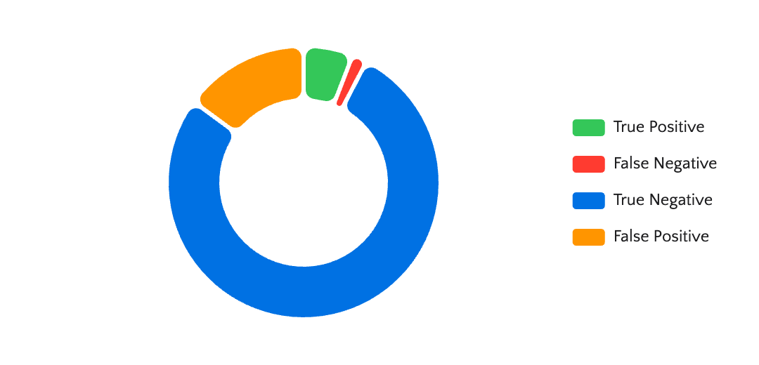
Model Interpretation & Insights
Understanding Predictions
Prediction Accuracy by Sport
Age Distribution of Medalists
Correct vs Incorrect Predictions
Key Interpretation Insights
Individual Sports
Higher prediction accuracy (89%) due to more consistent athlete performance patterns
Team Sports
Lower accuracy (76%) due to team dynamics and unpredictable variables
Age Sweet Spot
Peak medal probability at ages 23-28, declining significantly after 35
10 of 13

Slide 11
06 / Limitations & Future Work
Model Constraints & Improvements
Current Limitations
Future Improvements
Data Constraints
1
Real-Time Data Integration
Historical data only (1896-2016). No real-time factors like training conditions, injuries, or current form.
Incorporate athlete performance metrics, injury reports, and training data from wearable devices.
2
Ensemble Methods
Class Imbalance
Combine multiple models (XGBoost + Neural Networks + Random Forest) for improved accuracy.
Despite SMOTE, predicting rare medal events remains challenging. Model biased toward majority class.
3
Sport-Specific Models
Build separate models for each sport to capture unique success factors and improve precision.
Emerging Nations
Limited historical data for emerging Olympic nations reduces prediction accuracy for new competitors.
4
Advanced Feature Engineering
Include social media sentiment, weather conditions, and home-field advantage effects.
Missing Context
5
Deep Learning Approaches
Use LSTM networks to capture temporal patterns in athlete career trajectories.
No data on: training regimes, coaching quality, funding levels, political events, or doping history.
11 of 13

Slide 12

Conclusions
Olympic Success
Can Be Predicted
84.3% Accuracy
Country Matters Most
Experience Counts
XGBoost model achieved strong performance in predicting Olympic medal outcomes
National Olympic history is the strongest predictor, accounting for 18.4% of model decisions
Prior Olympic appearances and medals significantly increase prediction confidence
Our analysis demonstrates that Olympic medal outcomes are predictable using historical data and machine learning. While country investment and athlete experience are dominant factors, sport-appropriate physical attributes and age also play crucial roles. The model provides valuable insights for athletes, coaches, and sports analysts seeking to understand the drivers of Olympic success.
Machine Learning Project 3
Olympic Medal Prediction
12 of 13

Slide 13
THANK YOU
QUESTIONS.?
13 of 13

